Slide 1




Web-based Class Project on Ground Improvement
Prefabricated Vertical Drains
Prepared by:
Jenna Scorza
Greg Fox
Report prepared as part of course
CEE 542: Soil and Site Improvement
Winter 2014 Semester
Instructor: Professor Dimitrios Zekkos
Department of Civil and Environmental Engineering
University of Michigan
With the Support of:

Slide 2
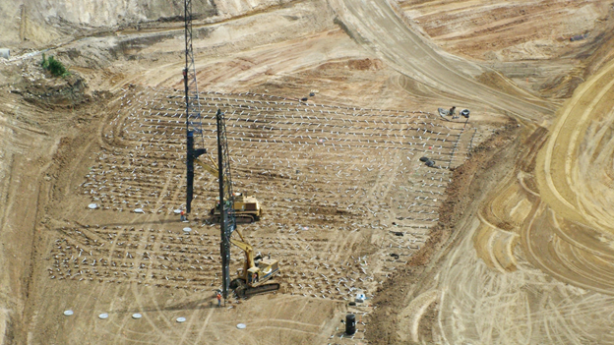
Prefabricated Vertical Drains
Greg Fox & Jenna Scorza

Slide 3
Introduction
Expediting consolidation of slow draining soils
Shorten pore water travel distance
Coupled with surcharge
Horizontal flow

Slide 4
History
1920s: sand drain patented
1930s: band-shaped vertical drain made of cardboard core and paper filter jacket
1980s: plastic PVD introduced and replaced predecessors

Slide 5
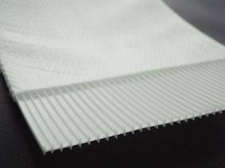
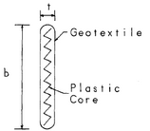
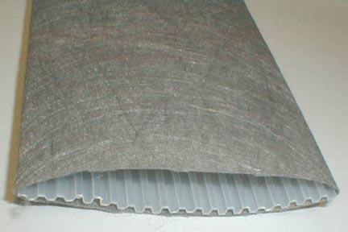
Features
Channeled plastic core wrapped with geotextile
Core:
Support for filter fabric
Provide longitudinal flow paths
Resistance to stretching and buckling
Jacket:
Acts as filter

Slide 6

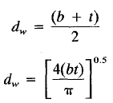
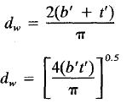
Features
Equivalent Diameter
Hanso 1979
Rixner 1986
Oblong shape, theories available derived for circular shape
Many equations have been suggested
Different assumptions = different results

Slide 7
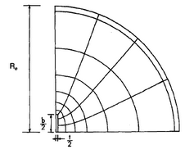

Features
Independent Evaluation
By Richard P. Lomg & Alvaro Covo
Analog Field Plotter
  Electrical potential to hydraulic head
  Electrical current to flow of water
Results agree with Suits et al. 1986
  Flow Net for Flow to Oblong Drain from Circular Surface

Slide 8
Benefits
Decrease primary consolidation time period
Decrease surcharge required for precompression
Increase rate of strength gain and stability
Compared to Sand Drains
  Economic competitiveness
  Less soil disturbance
  Improved speed and simplicity of installation
  Feasible nonvertical orientation and underwater installation

Slide 9
Disadvantages
Pre-excavation may be needed for very dense or stiff fills
Ground distrubance may not be tolerable in sensitive soils
Winter Considerations
  Frost line 3ft depth in MidWest
  Frost can reduce drain discharge
    Build up pack pressure
    Retard settlement development
    Lead to false premise that primary consolidation has reached an end

Slide 10
Suitable Soils
Implemented in soils that are moderately to highly compressible under static loading
Inorganic silts and clays of low to moderate sensitivity
Organic layers
Decomposed peat
Clayey and silty sands
Dredge spoils
Varved cohesive deposits

Slide 11
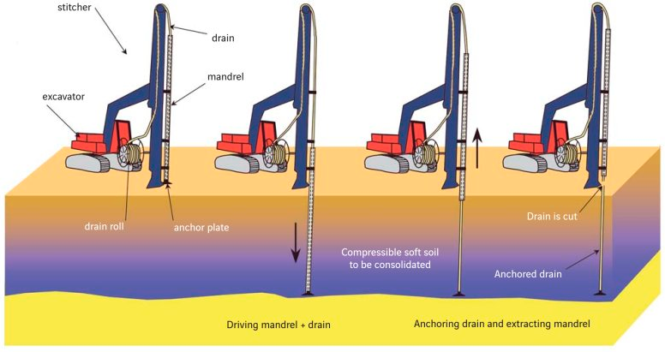
Installation
Steel mandrel encasing wick drain
Driven with vibrating (or static) force by stitcher
Drain anchored at desired depth, mandrel removed
Wick drain cut at surface
Depth and Width of drains selected based on soil stratigraphy and project specifications

Slide 12
Depth and Width of Installation
Drain should be extended into any available pervious soil layer below preconsolidation stress margin to assure discharge of water
Drains should be distributed across the entire footprint of an embankment and a small distance beyond

Slide 13
Design of Drains
Coefficient of Consolidation for Horizontal Drainage, c_{h}
c_{h} = (k_{h} / k_{v})*c_{v}
c_{v} from 1-D consolidation test
Coefficient of Permeability for Horizontal Seepage, k_{h}
k_{h} / k_{v} ~ 1 (conservative estimate)
lab/field testing
Coefficient of Permeability in Horizontal Direction of Disturbed Soil, k_{s}
k_{h}/k_{s} ~ 1~5
varies with soil sensitivity
Drain Influence Zone
D = 1.13s (Square)
D = 1.05s (Triangular)

Slide 14
Effectiveness of PVDs
Water Flow into Drain
  Hydraulic Conductivity
  Smear Zone
Discharge Capacity
  Design
  Installation
  Clogging
  Bending/Kinking
  Biological Degradation

Slide 15
Water Flow into Drain
Hydraulic Conductivity
k of surrounding soil will control water flow into drain

Slide 16
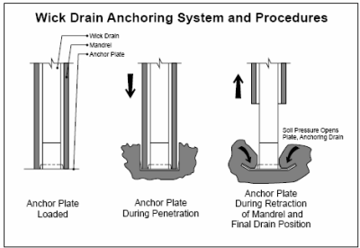
Water Flow into Drain
Smear Zone Development
Results from Installation of drains
  Mandrel to clamp drain
  Anchor Plate
    Keep drain in place
    Prevent soil entering through bottom of drain

Slide 17
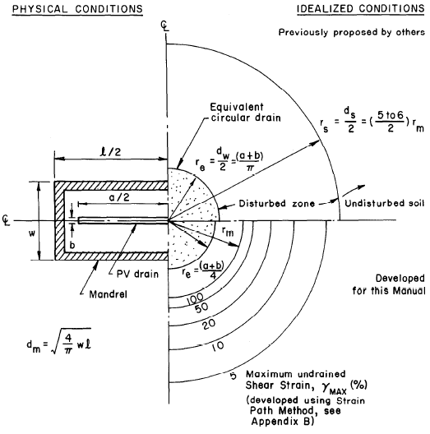
Water Flow into Drain
Smear Zone Idealization

Slide 18
Water Flow into Drain
Smear Zone Generalities
Larger Mandrel = Larger Smear Zone
Shape of Mandrel affects shape of smear zone
Square/Circular Mandrel = square/circular zone
Rectangular mandrel = ellipsoidal zone
Outer boundary of zone range 4~18 times mandrel radius
Ratio of hydraulic conductivity of undisturbed soil to smear zone ranges from 1~5

Slide 19
Discharge Capacity
Design & Installation
Design
  Cross Sectional Area - core available for flow
  Geosynthetic materials used
Installation
  Presents critical case for the mechanical properties of drain
    ASTM Grab, Puncture Tests

Slide 20
Discharge Capacity
Clogging & Biological Activity
Clogging
  Filter - Apparent Opening Size (AOS)
  Larger drain channel = less clogging
Biological Activity
  Depending on duration of project

Slide 21
Discharge Capacity
Bending/Kinking of Drain
Consolidation of soil results in bending and/or kinking of drain
Whether drain bends or kinks depends on
  Flexibility of drain (more flexibility leads to greater reduction in discharge capacity)
  Modulus of surrounding soil

Slide 22
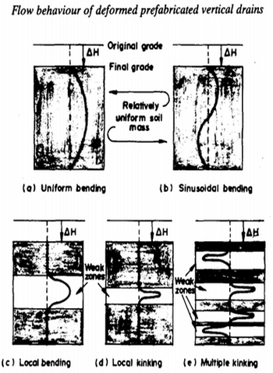
Discharge Capacity
Bending/Kinking of Drain

Slide 23
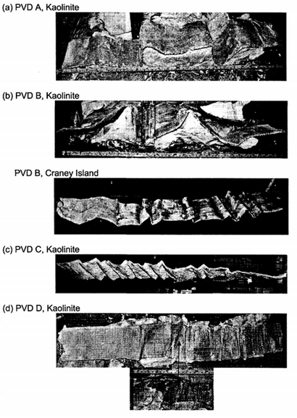
Discharge Capacity
Bending/Kinking of Drain

Slide 24
Recent Development & Future of PVDs
Recent Development
  Use of electronics for quality control
    Depth, Installation Force, GPS coordinates, date/time info.
    Necessity of such equipment depends on project
Future
  Precision of targeted geosynthetic function
  Understanding of smear zone and drain deformation are largest areas for improvement

Slide 25
Questions?

Slide 26
More Information
More detailed technical information on this project can be found at:
http://www.geoengineer.org/education/web-based-class-projects/select-topics-in-ground-improvement

