Slide 1




Web-based Class Project on Ground Improvement
Cement Additives for Permeation Grouting
Prepared by:
Olivia Marshall
David Quintal
Report prepared as part of course
CEE 542: Soil and Site Improvement
Winter 2014 Semester
Instructor: Professor Dimitrios Zekkos
Department of Civil and Environmental Engineering
University of Michigan
With the Support of:

Slide 2
More Information
More detailed technical information on this project can be found at:
http://www.geoengineer.org/education/web-based-class-projects/select-topics-in-ground-improvement

Slide 3
Cement Grout Additives
(Foam, Fly Ash, Slag and Silica Fume)
By David Quintal and Olivia Marshall
CEE 542
April 21, 2014

Slide 4
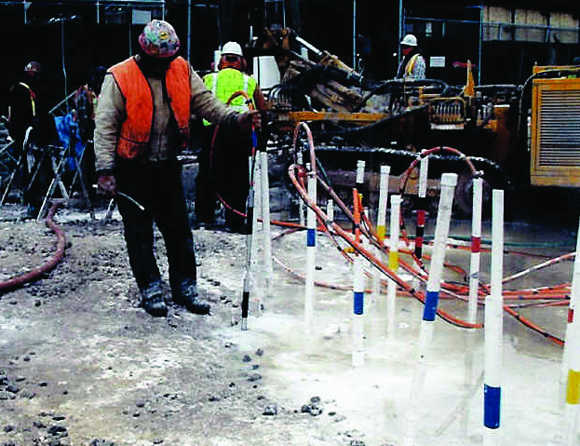
Introduction - Grouting
Injected into the ground to:
  Improve stability and strength
  Fill voids
  Water or contaminant control
Composed of cement and/or chemicals and other admixtures
Permanent

Slide 5
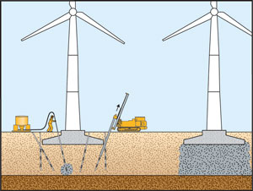
Introduction - Cement Additives
Additives in cement grout can:
  Improve strength
  Reduce permeability
  Reduce cost
  Impact set time
We considered:
  Foam
  Fly Ash
  Slag
  Silica Fume

Slide 6
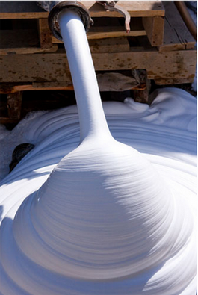
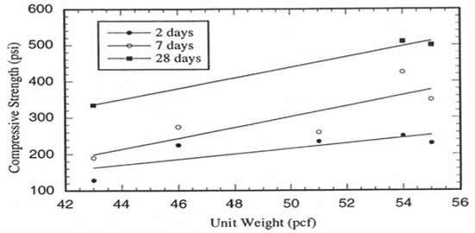
Foam (Cellular) Grout
Foaming agent used to create voids
Density ranges from about 30-80 pcf
28-day compressive strengths of 50-1200 psi

Slide 7
Foam (Cellular) Grout
Advantages
Free flowing (easy to pump, fills small voids)
Does not require compaction
Absorbs energy
Frost resistance
Good thermal insulation
Variable density and strength
Disadvantages
Low strength
High compressibility
If placed below the water table, the foam grout must be dense enough to displace the water

Slide 8
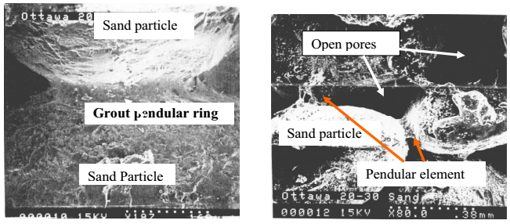
Foam (Cellular) Grout
Applications
Energy absorption
Low density backfill material
Sliplining
Tunneling
Stabilization

Slide 9
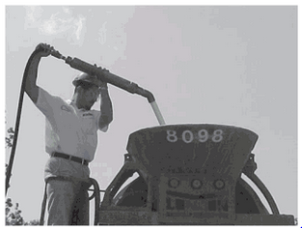
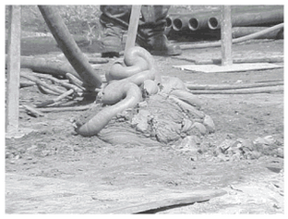
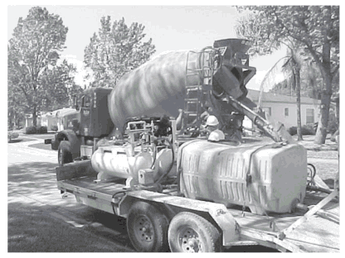
Foam (Cellular) Grout
Sinkhole Remediation in Hillsborough Florida
Grout only needed to be slightly stronger than the soil
40-60% grout/foam mixture resulted in a 20-25% cost savings

Slide 10
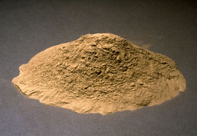
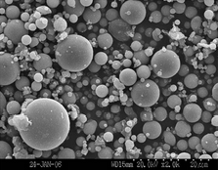
Fly Ash
By-product of coal combustion
Tiny glass spheres contain silica, alumina and calcium
Similar particle distribution to Portland cement
Two main types, class C and class F

Slide 11
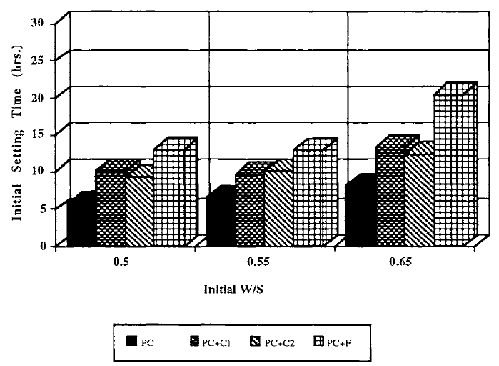
Fly Ash
Advantages
Low cost
Reduces heat generation during curing
Provides chemical stability
Reduces permeability
Increases flowability/pumpability
Reduction of shrinkage upon drying
Disadvantages
Reduced compressive strength
Delays setting time

Slide 12
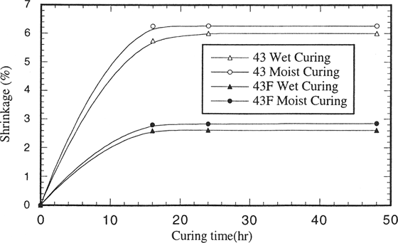
Fly Ash
Applications
Partial cement replacement for high volume applications
Sliplining
Positive environmental implications
Backfill around tunnel liner
  Channel tunnel backfill grouting in the UK

Slide 13
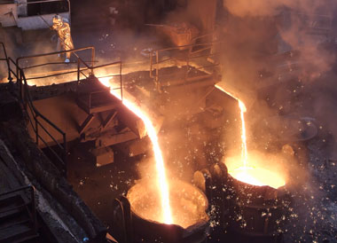
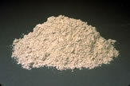
Blast Furnace Slag
By-product of iron
Will activate with the addition of Portland cement

Slide 14
Blast Furnace Slag
Advantages:
Increase strength
Low cost
Good cohesion
Sulfate resistance
Ability to immobilize harmful substances
No harm to environment
Delay set time

Slide 15
Blast Furnace Slag
Applications:
Dam foundation treatment
Mining fill
  Cementing tailings to contain and fill
Niagara river tunnel
  Displaced water
  Long set time for travel
  Desired strength, permeability, bleed, viscosity

Slide 16
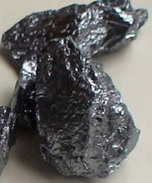
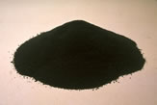
Silica Fume
By-product in extraction of silicon or ferrosilicon
Very small glassy spherical particles of SiO₂
Small amounts added to cement
Notes:
Semiconductor, 100 times smaller than fly ash/cement

Slide 17
Silica Fume
Advantages:
Reduces permeability
Improves stability and resistance to chemicals
Reduces viscosity
Reacts rapidly
Disadvantages:
Expensive
Difficult to handle small particles

Slide 18
Silica Fume
Applications:
Underwater grouts
Chemically harsh environments (oil wells)
Grouted piles - for adhesion and corrosive resistance

Slide 19
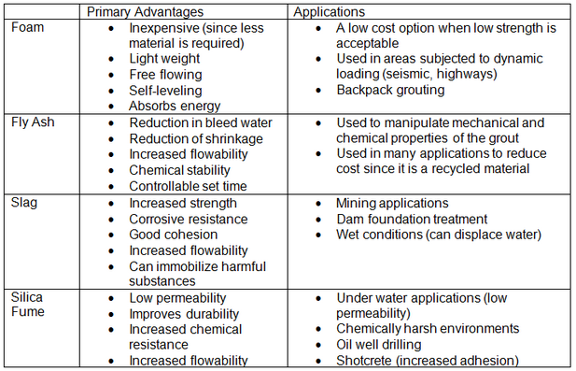
Conclusions

Slide 20
Thank You
Questions?

Slide 21
References
Aitcin, P.-C., Ballivy, and G., Parizeau, R. (1984) “The Use of Condensed Silica Fume in Grouts.” American Concrete Institution, 8, 1-18.
Akbulut, S. and Saglamer, A. (2003) “The Effects of Silica Fume in Cement Grouting.” Ground Improvement Volume 7, No. 1, pp. 37-44.
Ali, L. and Woods, R. (2009) “Creating Artificially Cemented Sand Specimen with Foamed Grout.” Retaining walls, and Foundations, ASCE, Hunan, China, pp. 95-100.
Ali, L. (1992) “Dynamic Behavior of Soils Partially Grouted by Foaming Process.” Summary. <http://sunzi.lib.hku.hk/ER/detail/hkul/2986273>
Barnes, A.R. (2009) “Foamed Concrete: Application and Specification.” Excellence in Concrete Construction through Innovation. The Concrete Society, Camberley, UK. pp. 3-9.
Bruce, D. (2005) “Glossary of Grouting Terminology.” J. Geotech. Geoenviron. Engr., 131(12), pp. 1534-1542.
“Cellular Concrete.” (2014) <http://betibiza26.tumblr.com/post/75309065230/cellular-concrete>
Gause, C. and Bruce, D. A. “Control of Fluid Properties of Particulate Grouts: Part 2 - Case Histories.” <http://www.geosystemsbruce.com/v20/biblio/129%20Control%20of%20Fluid%20Properties%20-%20Part%202.pdf>
Henn, R. (2003) “AUA Guidelines for Backfilling and Contact Grouting of Tunnels and Shafts.” Chapter 6 Grout Properties, Chapter 7 Backfilling, pp. 75-87, 122-124.
Jefferis, S. and Wilson, S. (2012) “Mine Paste Backfill - The Use of Grouts at Massive Scale.” Grouting and Deep Mixing 2012, pp. 1879-1888.

Slide 22
Kaeck, W., Rhyner, F., Lacy, H., and Quasarano, M. (2009) “Grouting of Deep Foundations at the Thames River Bridge.” Contemporary Topics in Ground MOdification, Problem Soils, and Geo-Support, 249-256.
McGillivray, R., Williams, W., and Broadrick, R. (2012) “Development of a Response Plan and Grout System For Remediation of Sinkholes.” Grouting and Deep Mixing, ASCE, New Orleans, LA, pp. 1626-1633.
Midwest Mole. “Cellular Grouting.” <http://www.midwestmole.com/cellular-grouting.php>
Mirza, J. Saleh, K. Roy V. and Mirza, M. S. (1999) “ Use of HIgh Volume Fly Ash in Grouting Applications.” American Concrete Institution, 172, 281-298.
Norchem, (2013) “Applications.” Norchem Inc., <http://www.norchem.com/applications-repair-products-mortars-grouts.html>
Portland Cement Association. “Green in Practice 107 - Supplementary Cementitious Materials.” Technical Brief. <http://www.concretethinker.com/technicalbrief/Supplementary-Cementitious-Materials.aspx>
Ryan, C., Day, S., and McLeod, D. (2003) “Long-Distance Grouting, Materials and Methods.” Grouting and Ground Treatment, pp. 1640-1651.
University of Kentucky. (2014) “Fly Ash.” What are Coal Combustion By-Products (CCBs)? <http://www.caer.uky.edu/kyasheducation/flyash.shtml>
Vickars, R. and Clemence, S. (2000) “Performance of Helical Piles with Grouted Shafts.” New Technology and Design Development in Deep Foundations, pp. 327-341.
Vipulanandan, C. and Kumar, M. (2000) “Properties of Fly Ash-Cement Cellular Grouts for Sliplining and Backfill Applications.” Advances in Grouting and Ground Modification: pp. 200-214.
Weaver, K. and Bruce, D. (2007) “Grouting Materials.” Dam Foundation Grouting: Revised Edition, pp. 104-108.

