Slide 1






Web-based Class Project on Geoenvironmental Remediation
PHYTOREMEDIATION
Prepared by:
Darin McLeskey
Stefano Bruni
With the Support of:
Report prepared as part of course
CEE 549: Geoenvironmental Engineering
Winter 2013 Semester
Instructor: Professor Dimitrios Zekkos
Department of Civil and Environmental Engineering
University of Michigan

Slide 2
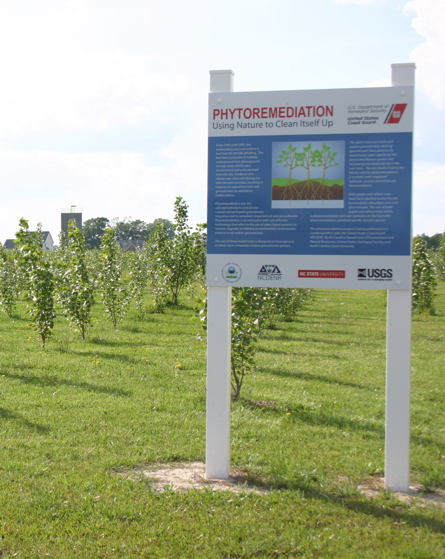
Concept/ Description
Within Bioremediation
Vegetation aides in contaminant breakdown/removal
Driven by nature, utilizes less inputs
Generally lower costs, but longer time
Positive public perception
Rapid growth rate

Slide 3
Theoretical Background
Many different biological processes
Plant root/ soil contact important
Rhizofiltration – Room membrane filtration
Phytodegragation – organic metabolization
Phytoaccumulation – inorganic accumulation
Rhizodegradation – breakdown and accumulation in root membranes, generally aided by microbes
Phytovolatilization – conversion to volatile forms
Phytoextraction – similar to pump and treat

Slide 4
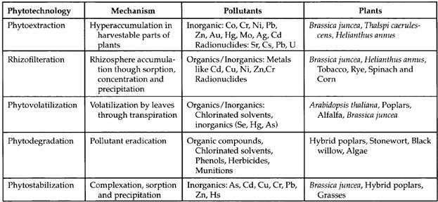
Theoretical Background

Slide 5
Applicability
Polishing treatment
Hydrocarbon residuals
Heavy metals
Chlorinated solvents
Pesticides/Herbicides/Radionuclides
Phenols/Munitions
Kow ratios of 1-3.5 have greatest potential
Low organic content in soil
Less than 10’ of contamination

Slide 6
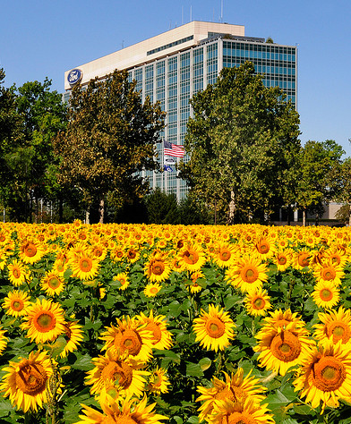
Advantages
Soil stabilization and pollutant fixation
Lower cost and less invasive
Performed in-situ
Aesthetically pleasing with public appeal
Excellent for agricultural soil damaged by dispersed industrial pollution

Slide 7
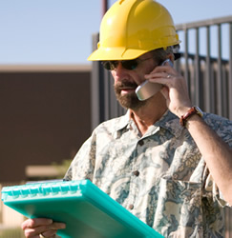
Disadvantages
Not fully embraced by government and industry
Depth limitation
Slow (3-5 year) timeline
Designs are very site-specific
Plant combinations can use more research
Equipment is often far from urban areas
Precaution for food-chain access

Slide 8
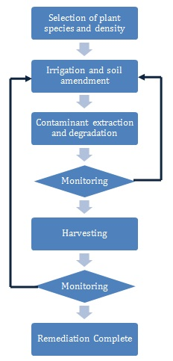
Field Setup
Define species
Irrigation/ nutrients
Treatment
Monitoring
Harvesting
Monitoring
Closure
Some process loops

Slide 9
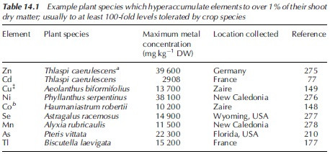
Plant Selection
Define type and quantity
Varying soil types
Select high biomass yield
Hyperaccumulator species
Background nutrient levels

Slide 10
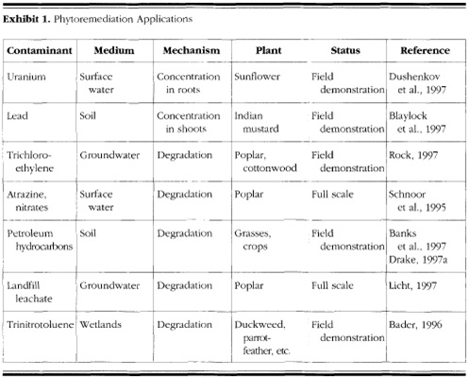
Application

Slide 11
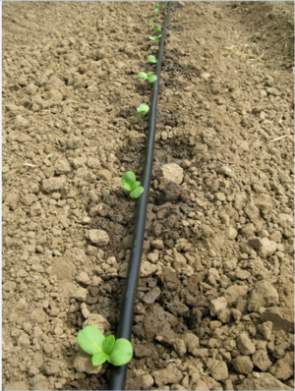
Irrigation/ Soil Amendment
Irrigation may be necessary
Water encourages pollutant dissolution
Repeated species reuse exhausts pollutants
pH adjustment, chelating for metal solubility

Slide 12
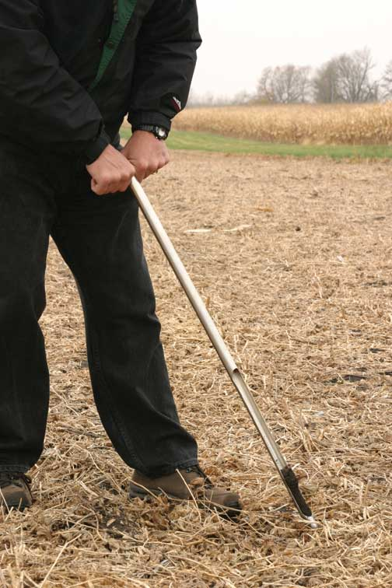
Monitoring
Continual sampling plan
  Soil
  Water
  Crops
Dynamic treatment strategy

Slide 13
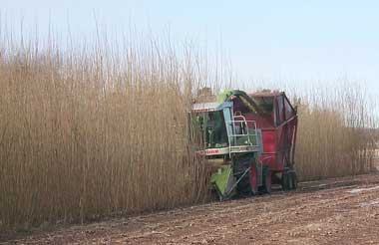
Harvesting
Mass balance for treatment efficiency
Accumulation in various plant parts
Composting or processing
Incineration
Used as “bio-enhanced” feedstock
Mineral ore potential

Slide 14
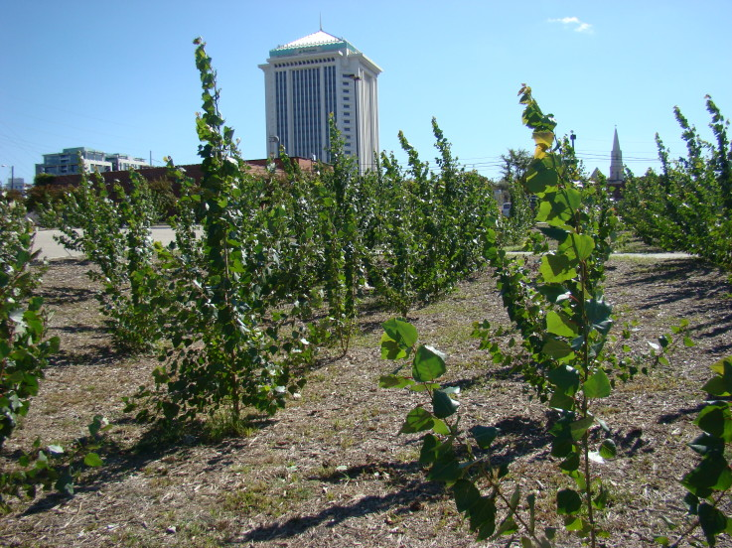
Cost
Low level: $10-15/ ton
Off site: $200-600/ ton
500 ppm lead example:
  $300,000 acre for disposal
  $110,000 for phytoremedation
Opportunity costs!

Slide 15
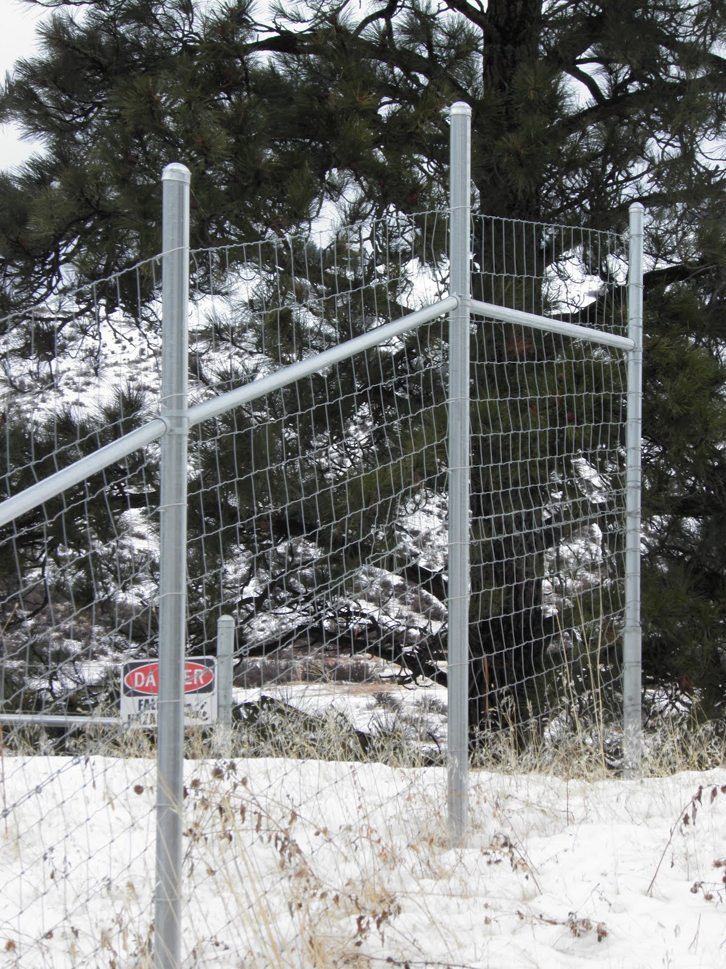
Due Care Considerations
Erosion prevention
Dust migration
Biomass in food chain
Pest/ rodent deterrents
Limit access to area

Slide 16
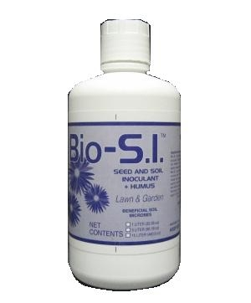
Modeling and Combinations
Four main models:
  Numerical and Analytical
  Developed in mid-90s
  All have severe limitations
Combined with other methods:
  Bioremediation & inoculation
  Polishing treatment

Slide 17
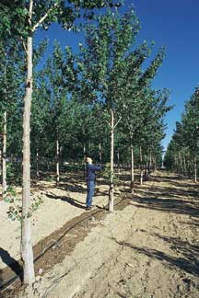
OneSITE WWTP – Woodburn, OR
10,000 Poplar trees over 400 acres
Abandoned sludge lagoon
Stabilize waste/ buffer
Alternative to 5 million gallon untreated release
$2.5 million cost
$800,000 harvest every 10 years

Slide 18
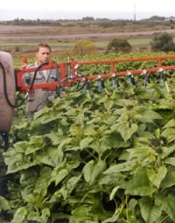
Radionuclide Extraction - Chernobyl
Fallout in sandy soil
Indian mustard, corn, peas, artichoke, sunflowers
Only artichoke and sunflowers were effective
Decrease only over 3 weeks
Chelating increased uptake 20x
Incineration used for 90% waste reduction

Slide 19
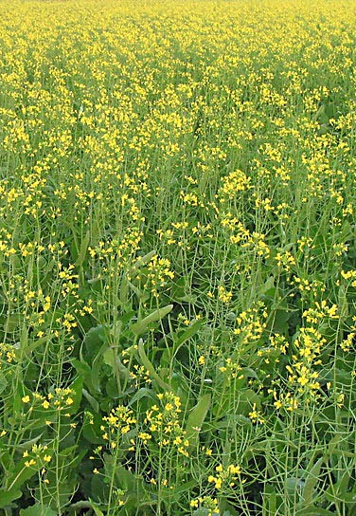
Lead Phytoremediation – NJ
Lead-acid battery factory
4500 sq. ft.
Close to church, school, homes
XRF for continual monitoring
Indian Mustard – 3.5” pots
EDTA for lead solubility
6 week growing cycle

Slide 20
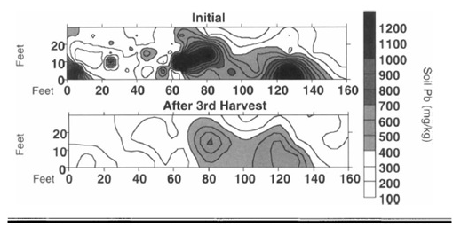
Lead Phytoremediation - Results

Slide 21
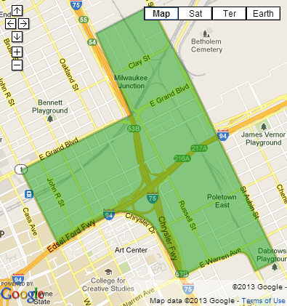
Local Example – Milwaukee Junction
Historic industrial area
High vacancy
Near transit and new developments
5-10 year development timeline
Dispersed pollutants

Slide 22
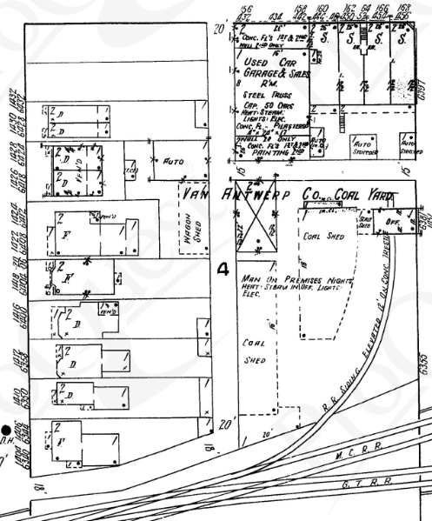
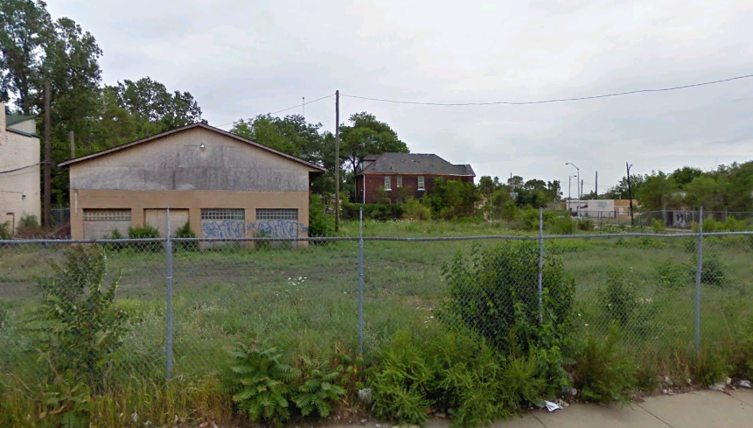
Local Example – Milwaukee Junction
Summer pilot project
  Van Antwerp Coal Yard
  Later automotive service center
  Lead, arsenic, hydrocarbons
  Mapping entire district

Slide 23
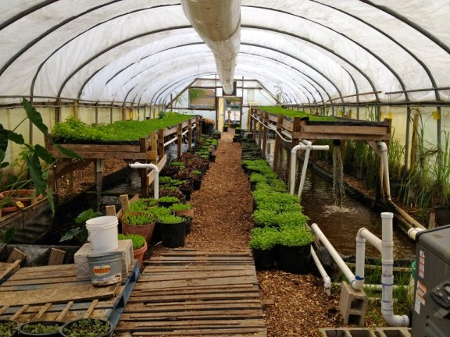
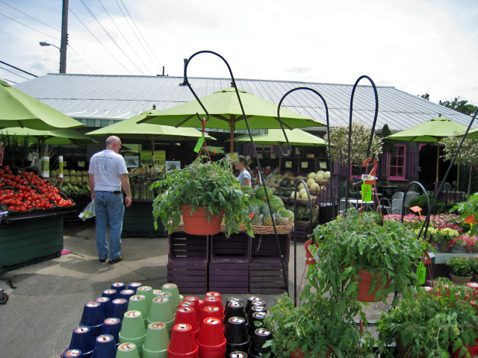
Local Example – Milwaukee Junction
Soil testing and delineation
Sunflower & Indian Mustard interplanting
Near incinerator facility
Indoor hydroponics and retail nursery
End use – BHARN
  Brush Hydroponics/ Aquaculture Retail Nursery

Slide 24

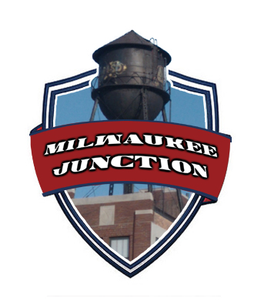



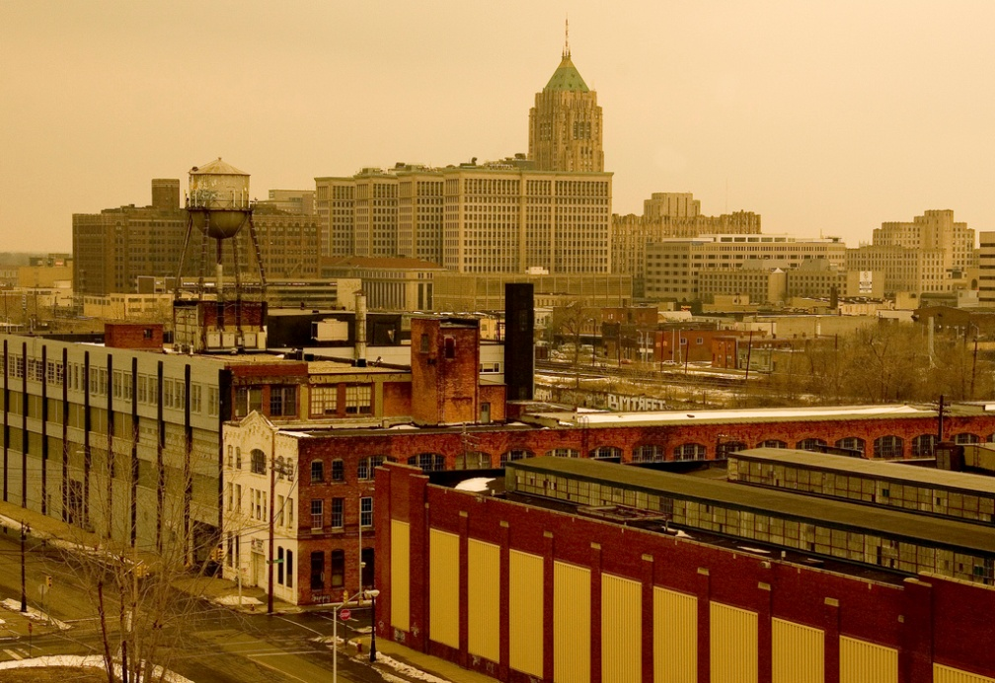
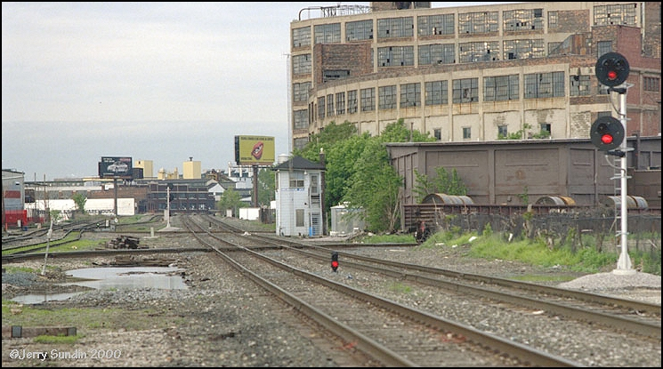
Local Example – Milwaukee Junction
Collaboration:

Slide 25
References
Sharma, H.D., Reddy K.R. (2004). “Geoenvironmental Engineering.” Jon Wiley & Sons, Hoboken, New Jersey, 478-485
Doty, S.L. (2008). “Enhancing phytoremediation through the use of transgenics and endophytes.” New Phytologist (2008) 179: 318–333
Blaylock, M.J., Elless, M.P., Huang, J.W., Dushenkov, S.M. (1999). “Phytoremediation of Lead-Contaminated Soil at a New Jersey Brownfield Site.” Remediation, summer 1999; 93-101
Chaney, R.L., Broadhurst, L., Centofanti, T. “Phytoremediation of Soil Trace
Elements.” Bioavailability, Risk Assessment and Remediation; 311-352
Rock, S.A., Sayre, P.G. (1998) “Phoremediation of Hazardous Wastes: Potential Regulatory Acceptability.” Remediation, autumn 1998; 5-17
Zadrow, J.J. (1999). “Recent Applications of Phytoremediation Technologies.” Remediation, spring 1999; 29-36
Mudhoo, A. (2011). “Phytoremediation of Cadmium: A Green Approach.”
Gupta et al. “Phytoremediation: An Efficient Approach for Bioremediation of Organic and Metallic Ions Pollutants.” Bioremediation and Sustainability; 213-240
Dushenkov, S., Mikheev, A., Prokhnevsky A., Ruchko, M., and Sorochinsky, B., Phytoremediation of radiocesium-contaminated soil in the vicinity of Chernobyl, Ukraine, Environ. Sci. Technol., Vol. 33, pp. 469-475, 1999.

Slide 26
More Information
More detailed technical information on this project can be found at:
http://www.geoengineer.org/education/web-based-class-projects/geoenvironmental-remediation-technologies

