Slide 1





Web-based Class Project on Geoenvironmental Remediation
VITRIFICATION
Prepared by:
Zhi Li
Tianshu Zhang
With the Support of:
Report prepared as part of course
CEE 549: Geoenvironmental Engineering
Winter 2013 Semester
Instructor: Professor Dimitrios Zekkos
Department of Civil and Environmental Engineering
University of Michigan

Slide 2
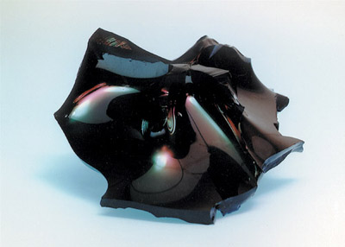
Introduction
Embeds contaminants into glass-like solids
Isolates contaminants from environment
Refreeze
Soil with contaminant
Glass-forming material
Heat to melt

Slide 3
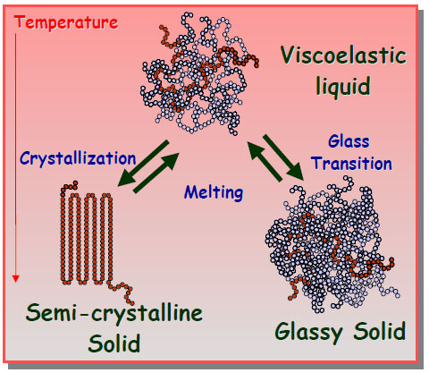
Theoretical Background
Vitrification
Glass-transition of amorphous material under cooling
Molecules do not form crystalline structure

Slide 4
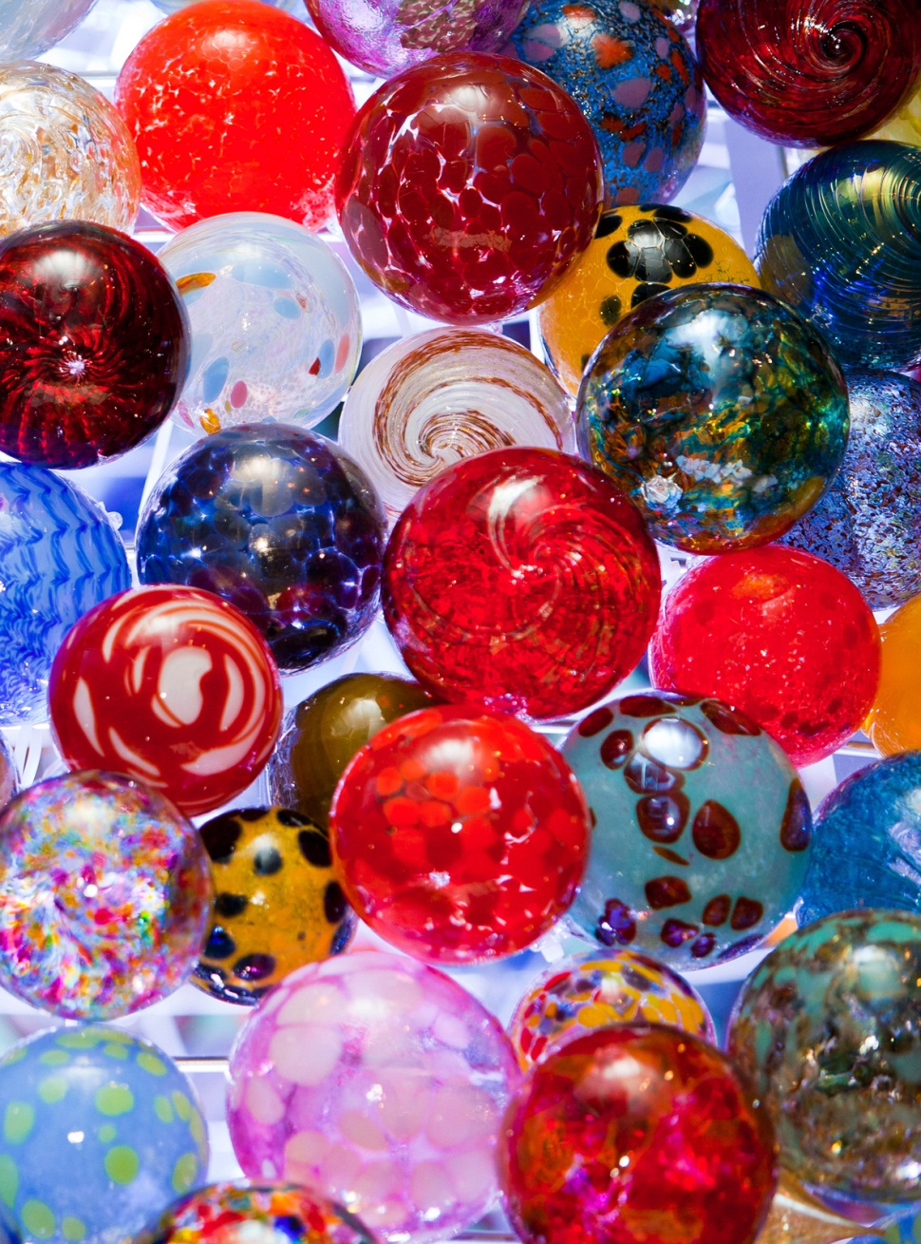
Characteristics
High strength
Low leaching
Chemically stable
Absorb foreign elements

Slide 5
Applicability
Types of Soil: All types
However, not recommended to:
High moisture content
High void ratio
Notes:
Any typical value for water content?

Slide 6
Applicability
Types of Contaminant: All Types
Recommended:
Radioactive waste
Heavy metal
Organic contaminant
Poisonous chemicals
Notes:
Organic contaminants at concentrations of 5 to 10% by weight and inorganic contaminants at concentrations of 5 to 15% by weight.

Slide 7
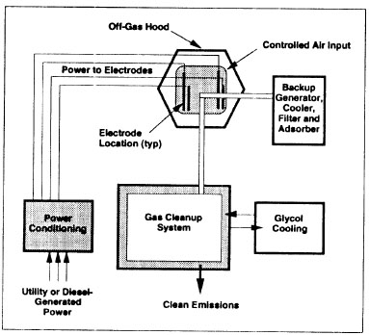
In-situ Vitrification (ISV)
Use electrodes to melt soil
Leave the product in place after treatment
Treat the gas generated

Slide 8
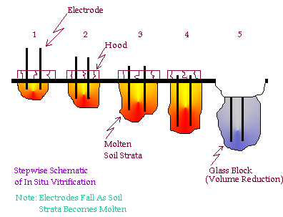
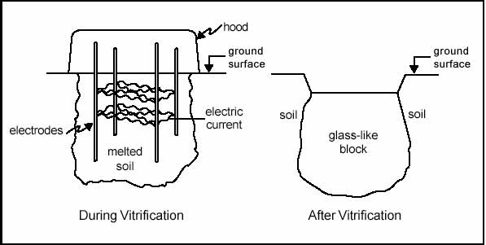
ISV Process

Slide 9
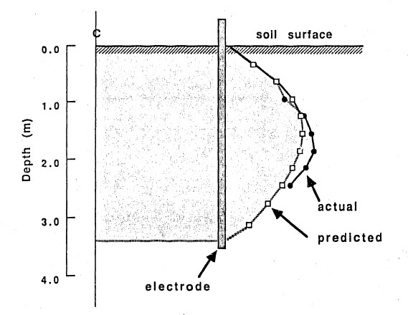
Koegler and Kindle’s Method
Mathematical model of vitrification
Predict vitrification time, depth, width, energy consumption
Very close to test result

Slide 10
Ex-situ Vitrification
Similar theory and process to ISV, but:
Excavate and transport contaminants
Vitrify contaminants in special reactors
Some use fossil fuels as energy source

Slide 11
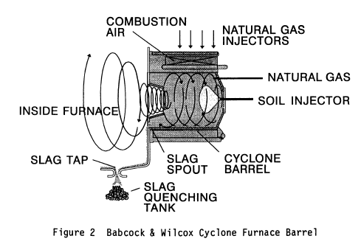
Vitrification Reactors
Examples:
Horsehead Resources Flame Reactor
Babcock and Wilcox Cyclone Furnace
Vortec Corporation Combustion and Melting System

Slide 12
Process Design
System Testing & Design
Processing Depth
Site Preparation
Transport equipment to site
Remove vegetation and excess soil
Grade the soil surface
Insert electrodes
Place starter material
Set-up and position off-gas collection hood and treatment system
Equipment Set-up
Application of Vitrification Process
Run the power system
Operate the off-gas treatment system
Monitor contaminant levels
System Operation
System Deconstruction
Remove off-gas collection hood
Disconnect off-gas treatment system
Remove equipment from site
Apply backfill to melt area
Perform other site restoration activities as needed
Site Restoration
Long Term Monitoring
Conduct periodic physical and chemical tests to evaluate the performance of the vitrification process, including durability, hydraulic conductivity and leachability tests on the vitrified products

Slide 13
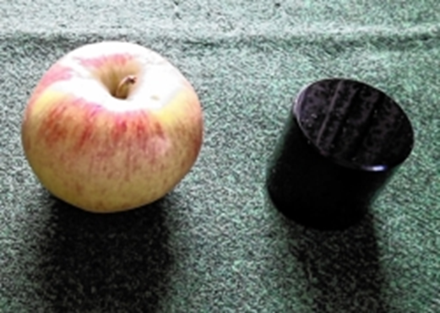
Advantages
Stability and durability of vitrified products
Durability tests showed that contaminants can be locked in vitrified waste glass for up to thousands of years
Volume Reduction
25 to 50% for most natural soils,
with maximum 96% for incinerator
ashes wastes
High applicability
Including various hazardous waste, such as
radioactive waste, organic contaminants, etc
Good acceptance of ISV; No excavation for ISV with reducing costs and improving safety
Notes:
a small piece of black glass representing the amount of vitrified highly radioactive waste that would be produced in respect of one person’s lifetime electricity consumption if it were all nuclear. It amounts to about five cubic inches.

Slide 14
Limitations
Soil water content and water recharge can limit ISV applicability.
Limited processing depth. To date, treatment depths attained is 20 feet.
Sufficient (2 to 5%) monovalent alkali cations must be present to provide the degree of electrical conductivity.
Not appropriate for sites adjacent to buildings, utility structures, or the property facilities.
Not proven to be safe for flammable liquid or combustible materials.
Notes:
Wet soil requires extra energy input to dry the soil, if the water recharge rate in the site exceeds the drying and melting rate of the soil, vitrification would be limited. Also the cost of remediation may increase by 10% for wet soils treatment.
The depth is influenced by several factors, such as spacing between electrodes, amount of power available, variations in soil composition and depth to groundwater.
3. If the natural material do not meet this requirement, fluxing materials such as sodium carbonate can be added to be base material.
For such kind of sites, insulating refractory walls can be installed but increasing costs.
This is because the sudden release of gases may exceed the heat load and volumetric capacity of the off-gas treatment system. Therefore, the amounts of contaminants which can be present for treatment by ISV are determined by the heat removal capacity of the off-gas treatment system.

Slide 15
Cost Estimation
Table 1. Cost estimation of sample ISV (Source: USEPA 1992a)
Year | Cost range ($/ton)
1965 | $117-165*
1966 | $96-210*
1988 | $163-349*
1989 | $166-175*
1990 | $103-382*
1991 | $360-390*
*Calculated from reported figures assuming 1.2 tons/yd³.
Factors influencing cost of ISV:
Depth of the soil to be treated
Extra energy input to treat high moisture content contaminants
The specific properties of the contaminated soil (e.g. dry density)
Unit price of electricity
Notes:
For recent years, cost estimates for ISV range from $300 to 650 per ton of contaminated soil treated. The most significant factor influencing cost is the depth of the soil to be treated.

Slide 16
Cost Estimation
Table 2. Cost comparison of selected soil technologies (modified Grubb and Sitar, 1995)
Technology | Cost ($/m³)
Bioremediation | 20-80
Permeable Reactive Walls | 65-130
Water Flooding | 65-130
Soil Vapor Extraction | 65-130
Radio Frequency Heating | 85-210
Soil Flushing | 100-160
Air Sparging | 100-160
Electro-osmosis | 100-200
Electrokinectics | 30-300
Vitrification | 300-650
Notes:
When treating waste materials for which only one remediation technology would be sufficient, vitrification is not recommended because of its higher unit cost than other conventional technologies. However, when treating waste materials that more than 1 technology are needed, vitrification can be a cost-effective remediation method for site containing various kinds of waste or contaminants.

Slide 17
Regulation Involved
The Comprehensive Environmental Respose, Compensation, and Liability Act (CERCLA)
The Resource Conservation and Recovery Act
The Clean Air Act The Safe Drinking Water Act
The Toxic Substances Control Act
The Occupational Safety and Health Administration Regulations
Notes:
This discusses specific federal environmental regulations pertinent to the operation of the ISV remediation technology, including the transport, treatment, storage, and disposal of wastes and treatment residuals.
State and local regulatory requirements could be more stringent, must also be addressed by remedial managers.

Slide 18
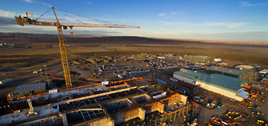
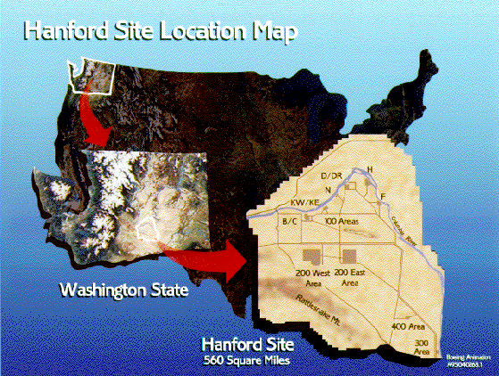
Case study —Hanford Vit Plant
Located in southeastern Washington state
Used to be the largest of three defense production sites in U.S.
56 million gallons of radioactive and chemical wastes are stored in 177 underground tanks on the site
New plant to treat hazardous waste are designed and built by Bechtel National, Inc.
Size: 440 feet by 275 feet by 95 feet tall
Estimated cost of $12.2 billion
Use vitrification technology, heating materials to 1,149 degrees Celsius
Facilities include pretreatment, low-activity vitrification, high-level waste vitrification, and an analytical laboratory

Slide 19
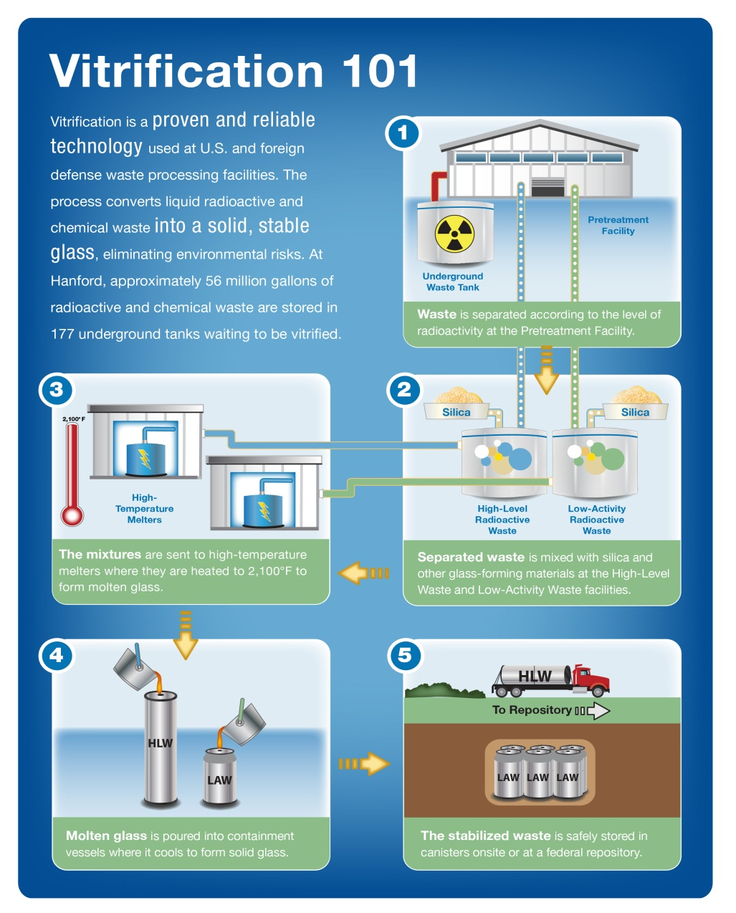
Case study —Hanford Vit Plant
Pretreatment to separate wastes
Mix separated wastes with glass-forming materials
Heat mixed wastes under 1,149 °C to form molten glass
Store stabilized wastes on site or at a federal repository
Pour molten glass into containment vessels to cool down and form solid glass

Slide 20
Reference List
[1]: Vitrification, <http://en.wikipedia.org/wiki/Vitrification>
[2]: Radioactive Waste, <http://en.wikipedia.org/wiki/Radioactive_waste#Vitrification>
[3]: Thermal Transitions: Crystallization, Melting and the Glass Transition, Penn State University, <http://zeus.plmsc.psu.edu/~manias/MatSE259/lecture7.pdf>
[4]: Glass Transition, the University of Southern Mississippi, Department of Polymer Science, <http://pslc.ws/macrog/tg.htm>
[5]: G Roth, S Weisenburger, (2000). Vitrification of high-level liquid waste: glass chemistry, process chemistry and process technology. Nuclear Engineering and Design. 202 (), pp.197
[6]: Michael I. Ojovan, William E. Lee, (2010). Glassy Wasteform for Nuclear Waste Immobilization. <http://link.springer.com/article/10.1007/s11661-010-0525-7/fulltext.html>
[7]: Laurel J. Staley, (1995). Vitrification Technologies for the Treatment of Contaminated Soil. (Chapter 9)
[8]: EPA, (1997). Vitrification of Soils Contaminated by Hazardous and/or Radioactive Wastes. EPA/540/S-97/501.
[9]: Louis J. Circeo, Robert C. Martin, (1997). In Situ Plasma Vitrification of Buried Wastes.
[10]: M. Paolone, R. Berti, C. A. Nucci, G. Camera Roda, P.L. Rossi, L. Bruzzi, A. Bazzi, (2003). A Research on Plants for In Situ Vitrification of Contaminated Soils. 2003 IEEE Bologna Power Tech Conference.
[11]: S.S.Koegler, C.H.Kindle, (1991). Modeling of the In-situ Vitrification Process.
[12]: Hanford VIT Plant, <http://www.hanfordvitplant.com/>
[13]: What is Vitrification，ALCOR, <http://www.alcor.org/Library/html/vitrification.html>
[14]: Meegoda, J., Ezeldin, A., Fang, H., and Inyang, H. (2003). â€Waste Immobilization Technologies.â€ Pract. Period. Hazard. Toxic Radioact. WasteManage., 7(1), 46â€“58.
[15]: Ewing, R. C., & Haaker, R. F. (1979). Naturally occurring glasses: analogues for radioactive waste forms (No. PNL-2776). Battelle Pacific Northwest Labs., Richland, WA (USA).
[16]: Pacific Northwest National Laboratory. (2005). "Waste Form Release Calculations for the 2005 Integrated Disposal Facility Performance Assessment".
[17]: Bingham, P. A., & Hand, R. J. (2006). Vitrification of toxic wastes: a briefreview. Advances in applied ceramics, 105(1), 21-31.
[18]: Scarinci, G., Brusatin, G., Barbieri, L., Corradi, A., Lancellotti, I., Colombo, P., ... & Dall'Igna, R. (2000). Vitrification of industrial and natural wastes with production of glass fibres. Journal of the European Ceramic Society, 20(14), 2485-2490.

Slide 21
More Information
More detailed technical information on this project can be found at:
http://www.geoengineer.org/education/web-based-class-projects/geoenvironmental-remediation-technologies

