Slide 1





Web-based Class Project on Geoenvironmental Remediation
THERMAL DESORPTION
Prepared by:
Ian McCreery
Lukas Vander Linden
With the Support of:
Report prepared as part of course
CEE 549: Geoenvironmental Engineering
Winter 2013 Semester
Instructor: Professor Dimitrios Zekkos
Department of Civil and Environmental Engineering
University of Michigan

Slide 2
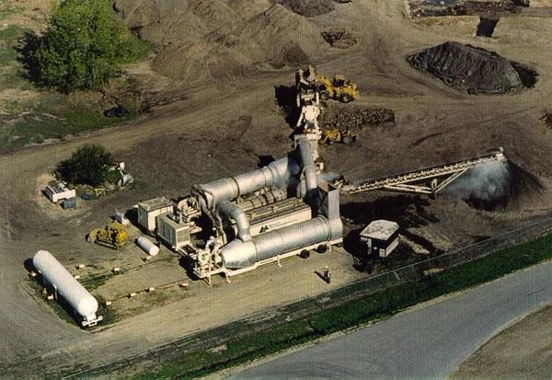
Thermal Desorption
Figure 1: “Thermal Desorption Unit” (Midwest Soil Remediation, 2013b)

Slide 3
Main Concept
Separates contaminants from soils by volatilizing contaminants
Gas stream is treated
Remediated soil can be reused onsite
Remediates organic wastes, fuels, PCBs, and chlorinated solvents

Slide 4
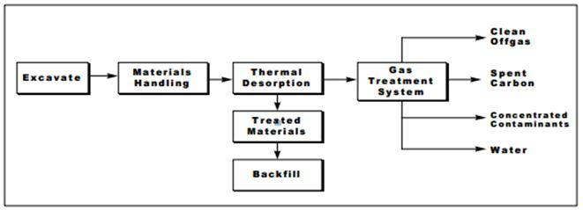
Processes Involved
Figure 2: Generalized Schematic Diagram for ex-situ thermal desorption (NFESC, 1998a)

Slide 5
Types of Thermal Desorption
In situ or ex situ
Ex situ
Batch or continuous
Co-current or counter-current
Direct and indirect heating
Low and high temperature (300 C)

Slide 6
Applicability
Contaminants
Volatile contaminants (300 to 1000 F)
Fuels, organics, and pesticides
Composition
Clay, silt, sand, or gravel
Particle size distribution
Fines may "carry over" (0.075 mm)
Large particles may damage equipment and lead to inefficient heating (2 in)
Moisture content
High moisture content leads to increased heating and increased material needing treatment

Slide 7
Advantages
High throughput
20 to 160 tons/hour
Time sensitive projects
Cost competitive for large volumes
Above 1200 tons
"Hot spot" treatment
Selective excavation
Soil reuse

Slide 8
Disadvantages
Requires excavation
In situ methods are uncommon
Ex situ involves removing soil and increasing exposure to workers and environment
Footprint or transportation
Size of system is large
Storage of soil is large
If offsite thermal desorption (TD) unit is used, transportation costs are high
Preprocessing
TD units require specific soil conditions (e.g. screening, dewatering)

Slide 9
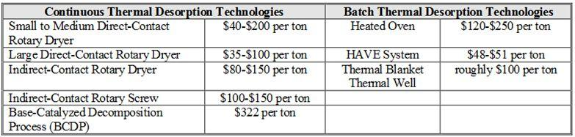
Cost
Table 1: Typical Cost Information (NFESC, 1998a)
Depends on:
Site conditions, type of TD unit, contractor
Only treatment cost displayed

Slide 10
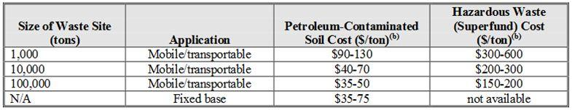
Cost
Table 2: Cost Comparison Data for Different Project Sizes (NFESC, 1998a)
Soil/contaminant characteristics dictate cost
Moisture content
Contaminant concentration

Slide 11
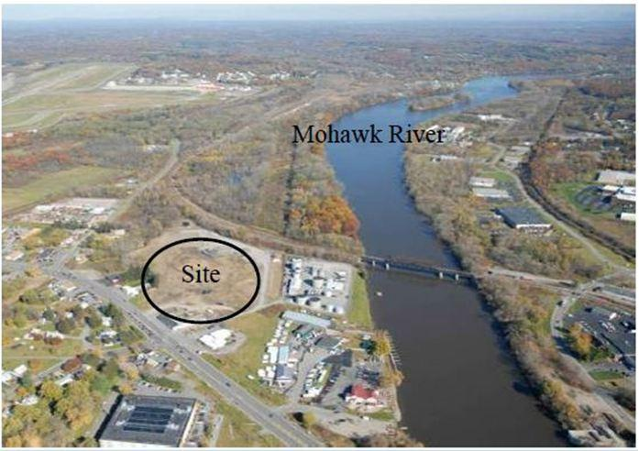
Case Study: 34 Freeman's Bridge Road
Figure 3: Aerial photo of 34 Freeman’s Road (Floess et al, 2011)

Slide 12
Case Study: 34 Freeman's Bridge Road
Contamination History
Located in Glenville, NY
Site previously owned by Kitchton Cooperage Company (KCC)
KCC dumped and recycled drums (non-hazardous waste)
Sold land in 1978 to Lyon's Ventures, Inc. (LVI)
LVI dumped hazardous/construction wastes

Slide 13
Case Study: 34 Freeman's Bridge Road
Remediation Timeline
1984 - NY State Dept of Environmental Conservation (NYSDEC) registered it as a class 2 hazardous waste site
Due to 80 55-gallon drums
LVI claimed to have moved drums, removed site from registry
1989 - drums "rediscovered"
Summer 1996 - site was considered for commercial development
December 1996 - site re-registered as class 2

Slide 14
Case Study: 34 Freeman's Bridge Road
Contamination
Investigation revealed following contaminants:
PCBs 33 ppm in soils < 2 feet deep
PCBs 980 ppm in soils > 2 feet deep
Other wastes included VOCs, SVOCs, heavy metals, and NAPLs
Mohawk River located within 90 meters of property line
Mohawk River considered suitable source of drinking water

Slide 15
Case Study: 34 Freeman's Bridge Road
Remedial Solution
Mapped contaminants in 50 ft by 50 ft by 2 ft cubes
Each cube classified in terms of its hazardous content
Environmental Soil Management, Inc. (ESMI)
Remediated non-hazardous material with direct heated thermal desorption
TD*X Associates (TD*X)
Remediated hazardous material with indirect thermal desorption

Slide 16
Case Study: 34 Freeman's Bridge Road
Outcome:
ESMI successfully treated contaminants
PCBs < 1 ppm
VOCs and SVOCs < 10 ppm
TD*X initially reached target goals
Roofing construction materials clogged system
TD*X developed solution at greater time and money costs
NYSDEC opted to transport and dispose remaining wastes
All material was backfilled to original site

Slide 17
References
Desnoyers, D. A., (2004). “Record of Decision: 34 Freeman’s Road Bridge Site.” New York State Department of Environmental Conservation.
Floess, C. H., Thorpe, M., Hoose, L., and McDonough, S. (2011). “Freeman’s Bridge Road Site Remediation Using Thermal Desorption.” Geo-Frontiers, 846-855.
Federal Remediation Technologies Roundtable (FRTR). (2008, July). “Data Requirements for Soil, Sediment, and Sludge.” <http://www.frtr.gov/matrix2/section2/2_2_1.html> (Mar. 11, 2013).
Mechati, F., Roth, E., Renault, V., Risoul, V., Trouve, G., Gilot, P. (2004). “Pilot Scale and Theoretical Study of Thermal Remediation of Soils.” Environmental Engineering Science, 21(3), 361-370.
Midwest Soil Remediation. (2013a). “More About Thermal Desorption.” <http://www.midwestsoil.com/thermal-desorption/more-about-thermal-desorption/> (Mar. 14, 2013).
Midwest Soil Remediation. (2013b). “Thermal Desorption Projects.” <http://www.midwestsoil.com/gallery/thermal-desorption-projects/> (Mar. 18, 2013).
Miller, S. M. (1997, August). “Site Review and Update: Industrial Latex Corporation.” New Jersey Department of Health and Senior Services, Consumer and Environmental Health Services.
Naval Facilities Engineering Service Center (NFESC). (1998a, June). “Application Guide for Thermal Desorption Systems.” NFESC, Port Hueneme, CA (Feb. 24, 2013).
NFESC. (1998b, February). “Overview of Thermal Desorption Technology.” NFESC, Port Hueneme, CA (Feb. 24, 2013).
RASCO, Inc. (1993, February). “Low Temperature Thermal Desorption Processes for the Remediation of Soils Contaminated with Solvents, Hydrocarbons, and Petroleum Products.” U.S. Army Environmental Center, Aberdeen Proving Ground, MD.

Slide 18
References
Sharma, H. D., and Reddy, K. R. (2004). “Thermal Desorption.” Geoenvironmental Remediation: Site Remediation, Waste Containment, and Emerging Waste Management Technologies, Wiley, Hoboken, NJ, 445-456.
Smith, M. T., Berruit, F., Mehrotra, A. K. (2001). “Thermal Desorption Treatment of Contaminated Soils in a Novel Batch Thermal Reactor.” Ind. Eng. Chem. Res., 40(23), 5421-5430.
Sullivan, T. P., (1997). “Thermal Desorption: A Technology Review.” Texas A&M University.
United States Environmental Protection Agency (USEPA). (1994, October) “Chapter VI: Low-Temperature Thermal Desorption.” How to Evaluate Alternative Cleanup Technologies for Underground Storage Tank Sites: A Guide for Corrective Action Plan Reviewers, USEPA.
USEPA. (2001, February). “Low Temperature Thermal Desorption.” <http://www.epa.state.il.us/community-relations/fact-sheets/southeast-rockford/southeast-rockford-9f.html> (Mar. 14, 2013).
USEPA Office of Solid Waste and Emergency Response. (2003, June). “Cost and Performance Summary Report: Thermal Desorption at Industrial Latex Superfund Site.” USEPA.

Slide 19
More Information
More detailed technical information on this project can be found at:
http://www.geoengineer.org/education/web-based-class-projects/geoenvironmental-remediation-technologies

